Slide 1
Silicon Controlled Rectifier

Slide 2
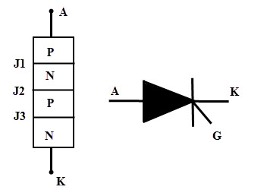
Introduction
The Silicon Controlled Rectifier (SCR) is the most important and mostly used member of the thyristor family.
SCR can be used for different applications like rectification, regulation of power and inversion, etc.
Like a diode, SCR is a unidirectional device that allows the current in one direction and opposes in another direction.
SCR is a three terminal device; anode, cathode and gate as shown in figure.
SCR has built in feature to turn ON or OFF and its switching is controlled by biasing conditions and gate input terminal.
This results in varying the average power delivered at the load , by varying the ON periods of the SCR. It can handle several thousands of voltages and currents.
SCR symbol and its terminals are shown in figure.

Slide 3
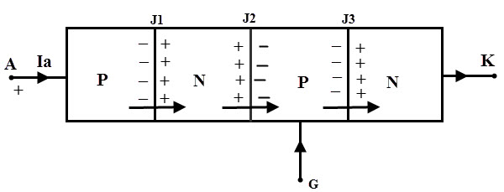
Construction of Silicon Controlled Rectifier
The SCR is a four layer and three terminal device.
The four layers made of P and N layers, are arranged alternately such that they form three junctions J1, J2 and J3.
These junctions are either alloyed or diffused based on the type of construction.
The outer layers (P and N-layers) are heavily doped whereas middle P and N-layers are lightly doped.
The gate terminal is taken at the middle P-layer, anode is from outer P- layer and cathode is from N- layer terminals.
The SCR is made of silicon because compared to germanium leakage current in silicon is very small.

Slide 4
Working or Modes of Operation of SCR
Depending on the biasing given to the SCR, the operation of SCR is divided into three modes. They are
Forward blocking Mode
Forward Conduction Mode and
Reverse Blocking Mode

Slide 5
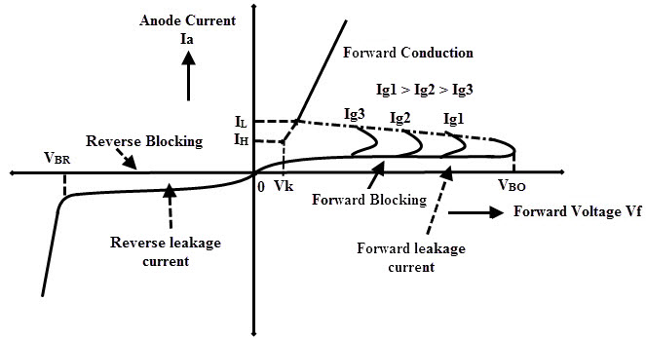
Forward Blocking Mode
In this mode of operation, the Silicon Controlled Rectifier is connected such that the anode terminal is made positive with respect to cathode while the gate terminal kept open.
In this state junctions J1 and J3 are forward biased and the junction J2 reverse biased.
Due to this, a small leakage current flows through the SCR.
Until the voltage applied across the SCR is more than the break over voltage of it, SCR offers a very high resistance to the current flow.
Therefore, the SCR acts as a open switch in this mode by blocking forward current flowing through the SCR as shown in the VI characteristics curve of the SCR.

Slide 6
Forward Conduction Mode
In this mode, SCR or thyristor comes into the conduction mode from blocking mode.
It can be done in two ways as either by applying positive pulse to gate terminal or by increasing the forward voltage (or voltage across the anode and cathode) beyond the break over voltage of the SCR.
Once any one of these methods is applied, the avalanche breakdown occurs at junction J2. Therefore the SCR turns into conduction mode and acts as a closed switch thereby current starts flowing through it.
Note that in the VI characteristic figure, if the gate current value is high, the minimum will be the time to come in conduction mode as Ig3 > Ig2 > Ig1.
In this mode, maximum current flows through the SCR and its value depends on the load resistance or impedance.

Slide 7
It is also noted that if gate current is increasing, the voltage required to turn ON the SCR is less if gate biasing is preferred.
The current at which the SCR turns into conduction mode from blocking mode is called as latching current (IL).
And also when the forward current reaches to level at which the SCR returns to blocking state is called as holding current (IH).
At this holding current level, depletion region starts to develop around junction J2.
Hence the holding current is slightly less than the latching current.

Slide 8
Reverse Blocking Mode
In this mode of operation, cathode is made positive with respect to anode. Then the junctions J1 and J3 are reverse biased and J2 is forward biased. This reverse voltage drives the SCR into reverse blocking region results to flow a small leakage current through it and acts as an open switch as shown in figure.
So, the device offers a high impedance in this mode until the voltage applied is less than the reverse breakdown voltage VBR of the SCR. If the reverse applied voltage is increased beyond the VBR, then avalanche breakdown occurs at junctions J1 and J3 which results to increase reverse current flow through the SCR.
This reverse current causes more losses in the SCR and even to increase the heat of it. So there will be a considerable damage to the SCR when the reverse voltage applied more than VBR.

Slide 9
Advantages of Silicon Controlled Rectifier
As compared with electromechanical or mechanical switch, SCR has no moving parts. Hence, with a high efficiency it can deliver noiseless operation.
The switching speed is very high as it can perform 1 nano operations per second.
These can be operated at high voltage and current ratings with a small gate current.
More suitable for AC operations because at every zero position of the AC cycle the SCR will automatically switch OFF.
Small in size, hence easy to mount and trouble free service.

Slide 10
Summary
The Silicon Controlled Rectifier behaves like a switch with two states that is either non-conducting or conducting.
There are three modes in which SCR operates. Those are forward blocking, forward conduction mode and reverse blocking mode.
There are mainly two ways to turn ON the SCR that means either by increasing the voltage across the SCR beyond the break over voltage of the SCR or by applying a small voltage to the gate. The typical value of the gate is 1.5 V, 30 mA .
If the gate current is increased the SCR will turn ON at much reduced supply voltage.
The SCR cannot be turned OFF through the gate so to open the SCR, applied voltage must reduced to zero.
Silicon Controlled Rectifier can be used for both AC and DC switching applications.

